Slide 1

Classification of MRI imaging of ASD using deep learning methods
Submitters:
Nitzan Ezra
Lior Buzaglo
24-2-R-8
Supervisors:
Assoc. Prof. Miri Weiss-Cohen
Dr. Anat Dahan

Slide 2
The problem
What is Autism spectrum disorder (ASD)?
A brain-based disorder that involves social deficits and repetitive behaviors.
Traditionally diagnosed through behavioral assessments.
Motivation:
Early diagnosis improves social skills and communication in children with ASD and enhances quality of life for those affected.
Crucial for controlling and treating the disorder.
ASD affects one in 68 children in the United States.
Notes:
Autism spectrum disorder (ASD) is a brain-based disorder characterized by social deficits and repetitive behaviors traditionally diagnosed through behavioral assessments.
Early diagnosis during is important and can improve the social skills and communication problems of children with ASD and enhance their quality of life. In order to control and treat this disease, an early diagnosis is crucial.

Slide 3
Today, ASD diagnosis is based on behavioral and developmental evaluations.
The challenges:
Clinical Heterogeneity.
Genetic Diversity.
Diagnosis Based on Symptoms.
Our Goal:
Improve accuracy in detecting autism spectrum disorders.
Notes:
Today there is no unequivocal way to detect ASD, The traditional way is not always accurate and is based on behavioral tests. Based on DSM (Diagnostic and Statistical Manual of Mental Disorders) or behavioral diagnostic scales.
Several neurodevelopmental disorders have complex genetic and epigenetic features that lead to their phenotype(The outward physical expression of a genetic trait) and for some there is no single genetic marker for the diagnosis. therefore, the diagnosis is made phenotypically .a given phenotype may arise from a diverse set of biochemical processes. Similar symptoms can arise from different biochemical processes. 1.Clinical Heterogeneity: Autism encompasses a wide range of symptoms and severity levels. Individuals with autism can exhibit very different behaviors, communication abilities, and interests, making it challenging to establish uniform diagnostic criteria.
2. Genetic Diversity: Autism is not caused by a single gene or mutation but rather by a combination of different genes, which can affect in various ways. This makes it challenging to identify specific genetic factors that increase the risk of the disorder.
3. Diagnosis Based on Symptoms: The diagnosis of autism is primarily based on behavioral symptoms and observations, rather than on objective tests such as blood tests or imaging. This can lead to subjective assessments or differences in diagnosis between different doctors.
So far, the diagnosis of ASD and the selection criteria for clinical trials have been guided by the Diagnostic and Statistical Manual of Mental Disorders or behavioral diagnostic scales. In the case of disorders that are influenced by numerous genetic or environmental factors, such as autism spectrum disorders, the disadvantage of symptom-based criteria is that similar symptoms or phenotypes may result from a variety of biochemical processes. For this reason, only 10%–38% of cases with known genetic deficits have been reported, there are no simple or consistent genetic underpinnings to ASD.[2]

Slide 4
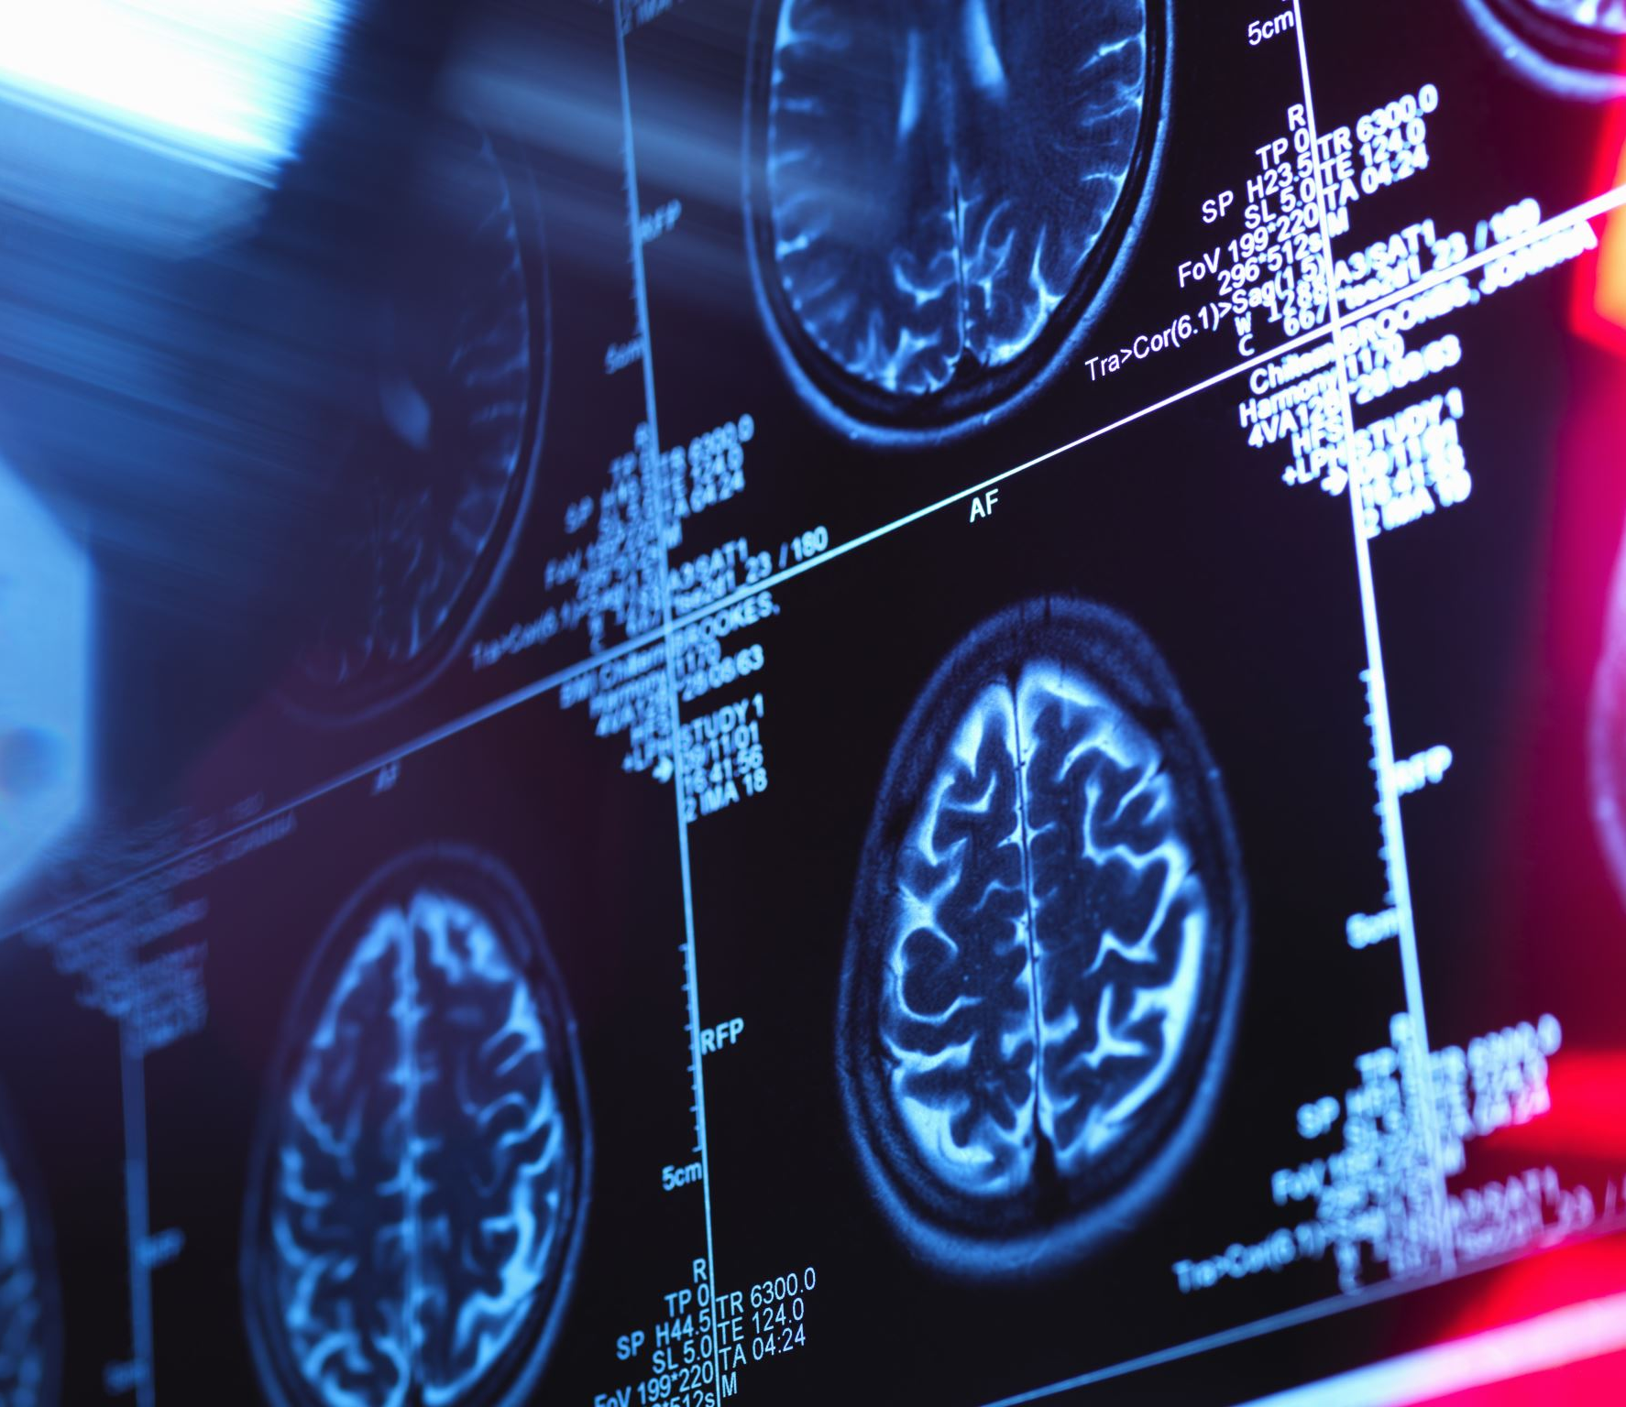
MRI
MRI, or Magnetic Resonance Imaging, is a medical imaging technique used to produce detailed images of the body's internal structures. It uses strong magnetic fields and radio waves to generate images of organs, tissues, and bones.
Types of MRI
Functional MRI (fMRI)
Structural MRI (sMRI)
Notes:
This reduced connectivity means that these areas may not communicate as effectively as they should, which could contribute to some of the challenges in social behavior, communication, and other cognitive functions that are characteristic of autism.
***********************

Slide 5
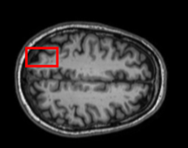
Autism Brain Imaging Data Exchange (ABIDE) Dataset
36 sites worldwide.
2,226 datasets: 1,060 ASD, 1,166 controls.
Ages: 5 to 64 years.
Includes resting-state fMRI, structural MRI.
We will use anatomical MRI scans at 256x256 pixels.
Notes:
The ABIDE dataset, used in our project, includes data from 36 sites worldwide with a total of 2,226 datasets. This comprises 1,060 datasets from individuals with Autism Spectrum Disorder (ASD) and 1,166 from control subjects. The dataset covers a wide age range, from 5 to 64 years, and includes resting-state fMRI, structural MRI, and enhanced phenotypic data. For our project, we will specifically use anatomical MRI scans with a resolution of 256x256 pixels.
In the picture below we see an anatomical MRI image of one of the patients in the ABIDE dataset.

Slide 6
Previous Research
Identification of Autism Spectrum Disorder Using Deep Learning and the ABIDE Dataset
Accuracy Achieved: 70%
Methods Used: Denoising Autoencoders (DAEs), Multilayer Perceptron (MLP) with functional MRI
Notes:
In the study 'Identification of Autism Spectrum Disorder Using Deep Learning and the ABIDE Dataset,' researchers achieved 70% classification accuracy using Denoising Autoencoders and a Multilayer Perceptron. Building on this, our project will use CNN-Inception V4 with Transfer Learning to aim for similar or better accuracy.

Slide 7
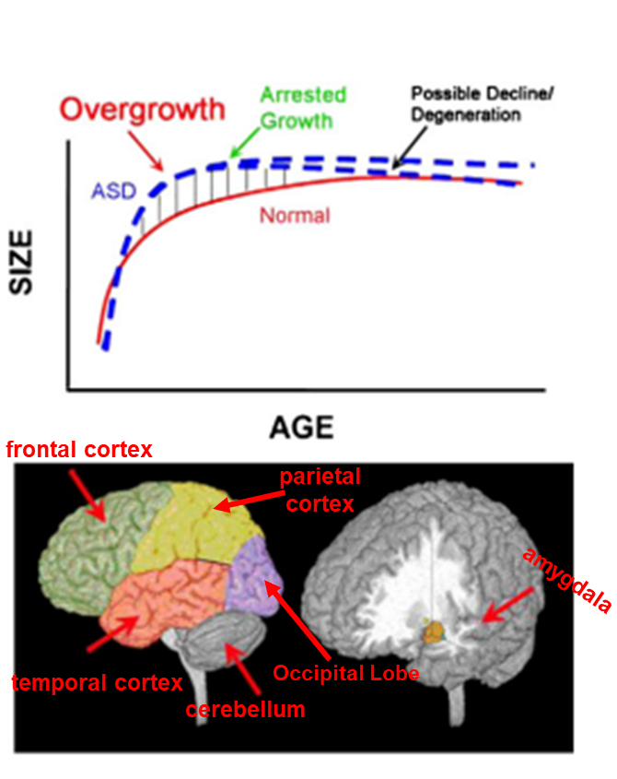
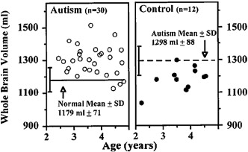
Findings
Normal Brain Size at Birth: The brain is a typical size, especially in the front and sides.
Early Childhood Growth: Total volume brain grows too much early on but becomes normal-sized by the teen years.
Irregulars cortical gray and white matter.
Notes:
The study found that people with Autism Spectrum Disorder (ASD) show distinct patterns of brain growth. At birth, brain volume is normal, especially in the frontal and temporal regions. However, in early childhood, individuals with ASD experience rapid brain growth in areas like the frontal cortex, temporal cortex, cerebellum, parietal cortex, occipital lobe, and amygdala. This overgrowth tends to level off in adolescence, but some may show reduced growth or even degeneration in certain areas.
The study's graph shows that ASD individuals (blue line) have larger brain volumes compared to typically developing individuals (red line), who have a smoother growth pattern. Additionally, abnormalities in cortical gray and white matter volumes were consistently observed in ASD. For boys aged 2 to 4, 90% of those with ASD have brain volumes larger than the average, unlike typically developing boys, where only one had a volume exceeding the ASD average.

Slide 8
Suggested Solution
We will use CNN-Inception v4 with transfer learning to classify the anatomical MRI images.
Our model will classify anatomical MRI scans, distinguishing ASD participants from control using brain imaging data from ABIDE and attempting to unveil the neural patterns that emerged from the classification.
Success Criteria: Achieve at least 70% accuracy.
Notes:
In this project, we investigated ASD patients' brain imaging data from a worldwide multi-site database known as ABIDE (the Autism Brain Imaging Data Exchange) to improve ASD diagnosis accuracy and reliability.
Images will be classified using deep learning and CNN-Inception v4 architecture.

Slide 9
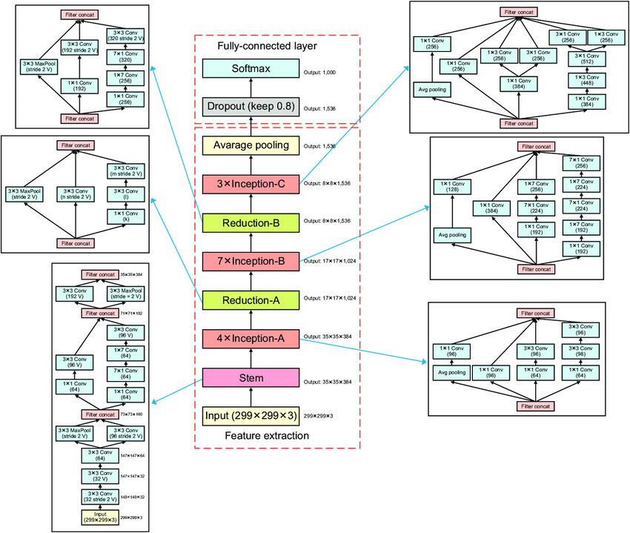
Inception-V4
Notes:
Fig 6: On the left is the overall schema for the pure Inception-v4 network. On the right is the detailed composition of the stem [4]. Stem: Initial convolutional and pooling layers that process the input image, extracting low-level features (e.g., edges, textures). Inception-A: A module that applies multiple convolutional filters in parallel (1x1, 3x3, 5x5) to capture different feature scales, followed by concatenation. Reduction-A: A downsampling layer using convolutions and pooling to reduce the spatial dimensions while preserving key features. Inception-B: A more complex inception module that adds larger filter sizes to capture more abstract features. Reduction-B: Another downsampling layer, more aggressive than Reduction-A, to further reduce spatial dimensions. Inception-C: A final inception block with deeper and more intricate filters for the most abstract and high-level feature extraction. Average Pooling: A global average pooling layer that reduces the dimensionality by computing the average across each feature map. Dropout: A regularization technique to prevent overfitting by randomly setting some units to zero during training. Softmax: The final layer that generates the class probabilities for classification tasks.

Slide 10
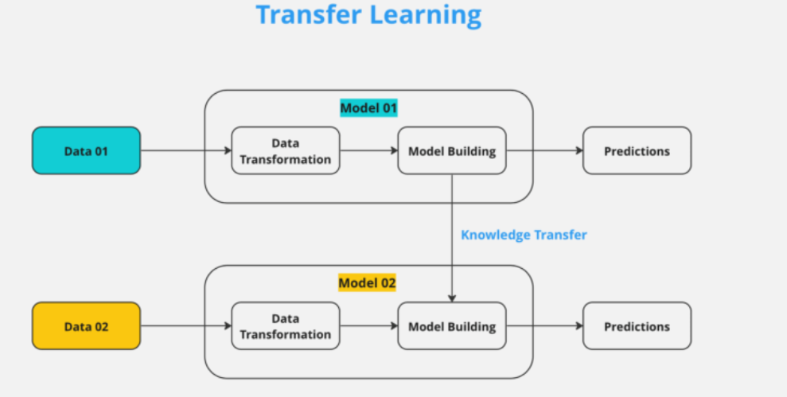
Transfer Learning
A technique where a model trained for one task is reused for a related task.
Advantages:
Requires less data and computational resources.
Improves the efficiency and effectiveness of deep learning applications.
Notes:
Transfer learning is a machine learning technique where a model developed for one task is reused for a different, but related, task. It leverages the knowledge gained from solving one problem to improve performance on another, often requiring less data and computational resources.
Using transfer learning accelerates the development of models for new tasks and significantly reduces the amount of data and computing resources required. Transfer learning improves the efficiency and effectiveness of machine learning applications in various domains by using already trained models, leading to more robust and generalized models

Slide 11
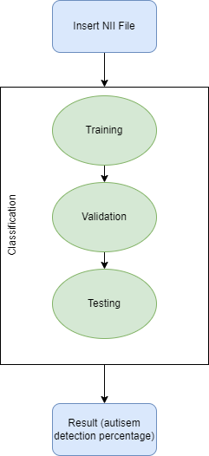
Model flow
Data Split: 80% Training , 15% Validation , 5% Testing
Hyperparameters:
Learning rates will be tested at 5e-4, 5e-5, and 5e-6. Epoch sizes range from 50 to 150.
The Batch Size 32 or 64.
The dropout rate of 0.2 to 0.5.
Notes:
Before starting the training process, we prepare the dataset. The dataset includes MRI images labeled as either ASD or non-ASD. The dataset is split, Training set 80%: Used to train the model. Validation set 15%: Used during training to monitor the model’s performance and help prevent overfitting. The test set 5%: Used after training to evaluate the model’s final performance. Loading Inception V4 model pre-trained on ImageNet. The early layers of the pre-trained model capture general features, which are useful for many tasks. Therefore, these layers are frozen during training to retain their pre-trained weights. Only the deeper layers will be trained to learn task-specific features. The final layer will have 2 output units with a softmax activation function to output probabilities for the two classes. A batch size of 32 or 64 images per batch is defined, depending on your hardware capabilities.
Training: Initially, only the new layers added to the model are trained, while the early layers from Inception V4 are frozen.
Validation: Monitor validation performance after each epoch to check for signs of overfitting or underfitting.
Testing: To evaluate the final performance, we will measure performance metrics such as accuracy, precision, recall, F1-score, and confusion matrix on the test set to assess how well the model generalizes to completely unseen data.
Once the model performs well on the training, we will fine-tune if necessary (canceling the freeze part or all of the model and continuing training with a smaller learning rate for better performance) [fig. 8].

Slide 12
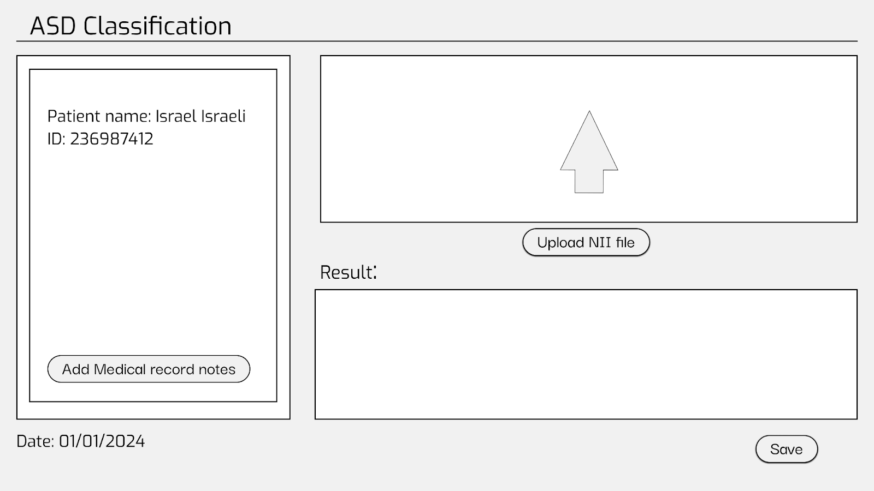
GUI – Main
Notes:
Overview of the Interface:
Overview of the Interface: This is the main interface for the ASD Classification System. On the left, we can see the patient's information, which includes the name and ID. This section allows medical professionals to input the patient’s details, such as notes or medical history, by clicking the 'Add Medical record notes' button
Upload Section: The center of the interface is where the user uploads the patient's MRI scan in .NII file format. This system is designed to take brain MRI images and process them for ASD classification. The large arrow icon indicates the area where the user can either click or drag and drop the MRI file.
Result Section:"Once the file is uploaded and processed, the result section at the bottom will display the prediction outcome. Currently, since no image is uploaded, the result area is empty, and the 'Save' button is disabled.

Slide 13
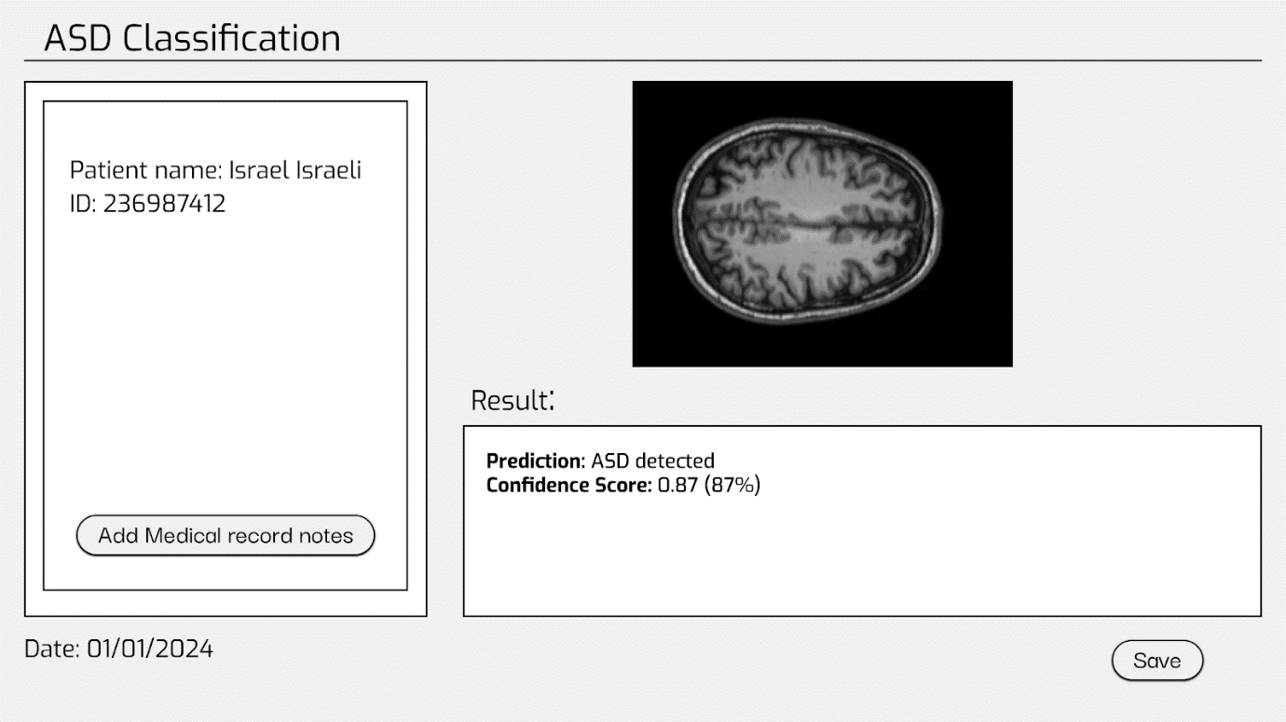
GUI – After Loading The Image
Notes:
Uploaded MRI Display: In the second interface view, the uploaded MRI file is shown in the top-right box. This allows the medical professional to visually confirm that the correct file has been uploaded.
Prediction Result: The result of the classification is displayed below the MRI image. In this case, the system has detected ASD with a confidence score of 0.87 (or 87%), indicating the system’s certainty about the prediction.
The confidence score helps the clinician assess how reliable the system’s prediction is, providing a helpful metric for decision-making
Saving the Result: The clinician now has the option to save the result using the 'Save' button on the bottom right, which will store the prediction and MRI in the patient’s record for future reference.
Functionality Recap: This simple yet powerful interface is designed for ease of use by healthcare professionals, allowing them to upload MRI scans, obtain results quickly, and save records efficiently.

Slide 14
Test Process
CASE # | Test explanation | Expected result
1 | Upload Nii file. | Sends the anatomical MRI scans as input to the model to start the enhancement process.
2 | Press->without upload anything. | Throw error: “Error! No file has been uploaded”.
3 | Insert wrong file type. | Throw error: “Error! The file type is not supported”.
4 | Insert empty file. | Throw error: “Error! The file is empty”.
5 | Press save (after uploading the file and receiving results) | Saves image to file system.
6 | Press save (before uploading the file and receiving results) | Throw error: “Please upload a file”
7 | Clicking on the "add medical record notes" button | Opening a window for entering information.
Notes:
1. Test Case 1: Uploading a Valid NII File
This test involves uploading a correct NII file containing anatomical MRI scans. The system should start processing the file and send the scans as input to the model to begin the enhancement and classification process.
2. Test Case 2: Pressing the Upload Button Without Selecting a File
In this case, the user tries to proceed without uploading any file. The expected result is an error message that reads: 'Error! No file has been uploaded.' This ensures that users are aware they need to provide a valid file before continuing.
3. Test Case 3: Uploading the Wrong File Type
Here, we test what happens when the user tries to upload a file that is not in the supported format, such as a .jpg or .png file. The system should throw an error: 'Error! The file type is not supported.' This prevents incorrect data from entering the system.
4. Test Case 4: Uploading an Empty File
If an empty file is uploaded, the system should detect this and return an error message: 'Error! The file is empty.' This ensures the system only processes valid MRI data.
5. Test Case 5: Saving the Result After a Successful Upload
Once the file has been uploaded and the results have been received, this test checks if the 'Save' button correctly stores the image and results in the file system. The expected behavior is that the result is successfully saved.
6. Test Case 6: Pressing the Save Button Without Uploading a File
If the user presses the 'Save' button before uploading any file, the system should prevent this by showing an error: 'Please upload a file.'This ensures that results are only saved after proper file upload and processing.
7. Test Case 7: Adding Medical Record Notes
When the 'Add medical record notes' button is clicked, a window should open, allowing the user to enter important information about the patient’s medical history or other relevant notes. This helps in maintaining detailed patient records.

Slide 15
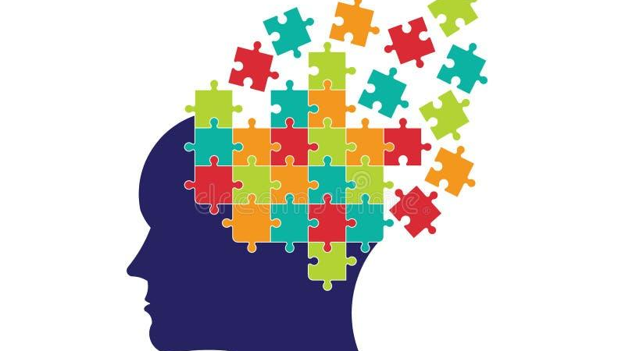
Thank you for Listening!

